Slide 1
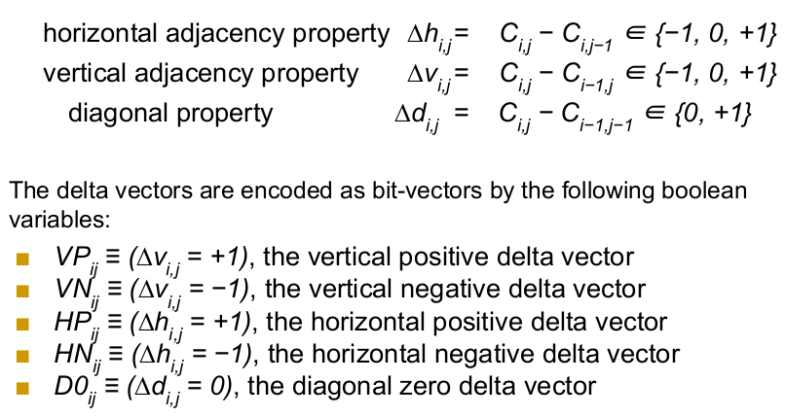
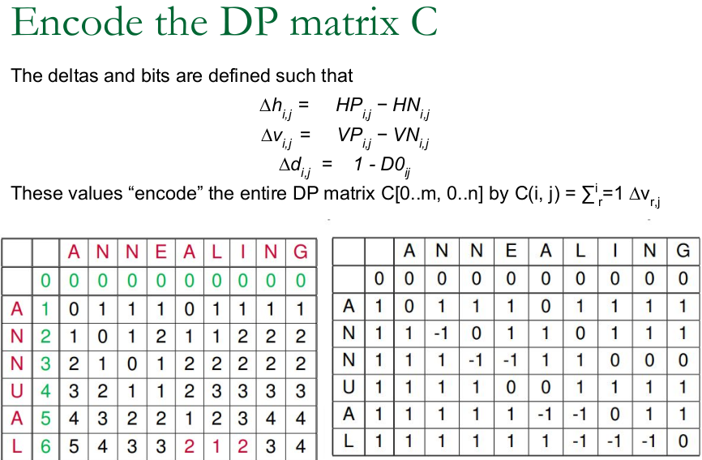
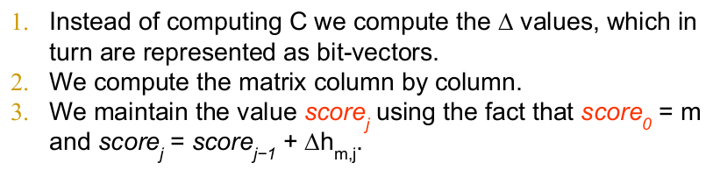
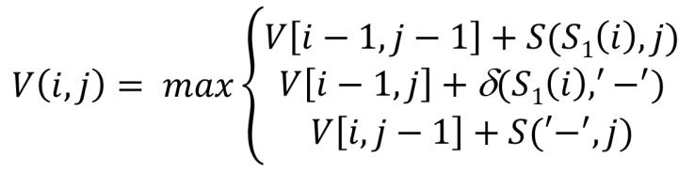
Four Russians Trick (Arlazarov, Dinic, Kronrod, Faradzev)
- Cover the DP table with t X t 1-overlapping blocks for t = logn / 4, since alphabet size is 4.
- Create alignment lookup for every possible score pair and the sequences for a specific block.
- Filter useless ones & create binary encoding for each posibility based on consecutive relationships between scores: 1 if difference, 0 otherwise. Lookup size: 2^t scores & 4^t strings, so O(n^(3/2)).
- Compute last row & column of every block based on first row & column encodings from the lookup & the sequences for that block.
Bit-parallel Alignment
For edit (Vladimir Iosifovich Levenshtein) distance where match=0, mismatch=1, gap=1.
- Encode the DP matrix using 1-word long bit vectors (32 or 64 bit based on the system).,
- Parallelize DP matrix using word-operations and resolve dependencies.
Multiple Sequence Alignment (MSA)
If classic alignment extended to k-strings, traverse n-dim space, O(2^k * n^k).
- p(y,j): Frequency of char y occuring in col j of profile C
- S(x,j): score of aligning x with col j of profile C
*** Sum over all char y in column j, score function(x,y) * p(y,j)
- V(0,j): Sum over col k <= j, S('-',k)
- V(i,0): Sum over all row k <= i, score func(kth char of sequence s, '-')
Alignment Strategies
Greedy: Iteratively align the most similar pair & expand the profile with seq having highest score w.r.t. the profile.
Progressive & ClustalW: Construct pairwise alignments, build phylogenetic tree using neighbourhood joining algorithm, progressive alignment guided by the tree.
Center Star: Choose the seq i having largest pairwise alignment score sum as center star, iteratively build alignment with the current best pairwise alignment with center star. Update the profile after every step.
Partial order alignment: Directed, acyclic graph (DAG) G where you have parents from waay before or all over the DP table. When computing alignment, do topological sort over the graph & visit the nodes in this order when computing DP entries.
Alignment Quality
- Sum of pairwise scores imposed by the MSA
- Entropy: sum for every column,
Sum over every char in column j, -1 * frequency of char c * log(frequency of char c)
If pure, entropy = 0, if all unique, it's 2.
- Number of matches, longest common subsequence of MSA

Slide 2
Phylogenetic Trees
- If distance Dij = tree distance between i & j, D is fitting.
- For 3 sequences, triangular shape with a node in center.
- Expending to n sequences gives (n chooses 2) equations with 2n-3 variables, not always possible to solve optimally when n > 3.
UPGMA
Ultrametric tree: distance from root to any leaf is the same.
- Compute distance between clusters as average pairwise distance between cluster elements.
- Merge the clusters closest by removing the clusters from the table and creating a new cluster at distance / 2.
- Update the distance between remaining clusters and the new cluster.
Neighbour Joining
Distance matrix D is additive if node distances in tree equal to the distance in D.
Degenerate triplets: Dij + Djk = Dik
- If any, remove j & reduce problem size
Four-Point Condition,
Dij + Dkl, Dik + Djl, Dil + Djk
Two are the same & one is less
If this is true for all triplets, additive
Least-squares distance phylogeny problem: Finding best appropriation tree T for non-additive matrix D, which is NP-hard.
Max Parsimony: Determine what chars at internal nodes would best explain character strings for n observed species.
Parsimony score: Sum of cost of all mutations found in the tree.
Small parsimony problem: Given a tree with each leaf labeled m-char string, find the tree minimizing the parsimony score.
Weighted small parsimony problem: Includes a scoring matrix to show penalty for mutations between chars. Otherwise, use Hamming distance.
Sankoff's Algorithm
s_t,parent = min_i{s_i(left_child) + penalty_i,t)} +
min_j{s_j(right_child) + penalty_j,t)}
- Scores at the root are computed by going up. After the lowest scored char selected for root, backtrack and assign chars contributing to the character of a parent from the children & assign it to the child.
- Remember that left & right children parsimony scores are computed separately.
Fitch's Algorithm: Assign a letter set to each vertex bottom to top. If intersection of children' sets is empty, take their union. Otherwise, use the intersection. Afterwards, arbitrarily assign a letter to the root from its set, go down the tree. If the letter of the root is in the node's label set, select it. Otherwise, choose arbitrarily.
- Sankoff & Fitch both O(nk) & identical if Sankoff uses Hamming distance.
Large Parsimony Problem: Problem of constructing a tree T with minimum parsimony score. (2n-3)! rooted & (2n-5)! unrooted possible trees. Problem is NP-complete. Branch-and-bound or heuristics for solution.
Similarity Search
Dot matrix – character-equalities shown with marks, empty otherwise. Afterwards, find the longest diagonal w/o mismatches & gaps.
- Approximate Pattern Matching: Find all approximate occurrences of a pattern in a text, runs in quadratic
- Query Matching Problem: Match substrings in a query to a text with at most k mismatches.
Instead of finding approximate matches, find short exact matches and expand along the diagonals instead. Assume k-mismatch problem. Split the pattern P into (k+1) regions of short l-mers. By pigeonhole principle, one region has to perfectly match the text & this is the basis of how longer matches can be found. Although the longer K gets the less performance you get due to computational overhead.
FAST-P
- Find short good k-mer matches
- Determine good k-mer matches & their endpoints
- Use DP to align the good matches
FAST-P extract 5 best diagonals and scores them using PAM250, w/o considering indels.
FAST-A: Instead of 5, choose 10 best diagonals. Eliminate the diagonals below a threshold before chaining.
BLAST: Search for short local alignments between k-mers of the pattern and the text, extend locally around the alignment. Original BLAST doesn't allow gaps, gapped BLAST does & usually finds better alignments at the cost of searching a larger local extension space.
FAST-A Variations: TFASTAX, TFASTAY, FASTAX, FASTAY
BLAST Variations: blastn, blastp, blastx, tblastn, tblastx, PSI-BLAST, Megablast, WU-BLAST (Wash U BLAST)

Slide 3
Minimap2
Indexing all k-mers for query matching is expensive since O(4^k) k-mers for DNA. Instead, use minimizer k-mers: hash only certain k-mers to reduce memory usage.
- Minimizer-based binning fragments the query into a few pieces. Based on sequence continuity some k-mer will occur in many long segments which can be used for binning.
- Each k-mer has a unique k-mer minimizer & will always to go the same bin.
Algorithm
- Collect minimizers from the text & create a hash table.
- For each query in database collect its minimizers and find exact matches in the text to be used as anchors.
- Apply chaining to merge overlapping (co-linear) anchors.
- Use DP to extend the ends of the chains & close the regions between the chains.
One-Dimensional Chaining
Endpoints of every interval sorted left to right. Process each point in sequence:
- If left end, max value of obtainable by this segment is current max + value of the interval.
- If right end, max = max of (cur_max, max value of obtainable by this segment)
Backtrack to retrieve the interval & cur_max reports the max value obtainable at the end.
Two-Dimensional Chaining
Assume you have 2-d local alignments. Get left & right ends of each rectangle and sort similar to 1-d case. Also, in a separate list get lowest y coordinate, value of the local alignment & the segment, sort w.r.t. lowest y-coordinate. Process x-list in ascending sorted order:
- If left-end, let this rectangle be k. Find the triplet for rectangle j that has the smallest y value which is greater than the largest y value of k. (First retangle to the left and above of k). Then, max possible value obtainable by k is V(k) = v(k) + V(j).
- If right-end, search for the first j that has highest y value less than y value of current rectangle k. Then, delete rectangles having largest y value less than or equal to this j (since you need to go low-right direction).
Maximal Unique Matches (MUMs): The longest substring that occurs in both texts exacly once. Has linear solution with generalized suffix trees.
- Extract MUMs in both genomes
- Sort matches in MUM aligment & extract the longest set of matches that occur in the same order in both genomes using longest increasing subsequence problem.
- Close the gaps using local alignments around the ends
- Compared to FASTA, MUM-based alignment is much less noisy.
- MUMs can also be used for MSA: iteratively split the sequences into smaller chunks until MSA becomes feasible & merge the sequences.
Maximal Exact Matches (MEMs): Exact matches that cannot be extended in either direction without breaking the equality. Relaxation over MUMs since uniqueness isn't a requirement.
Burrows-Wheeler Alignment MEMs (BWA-MEM): BWT with MEMs
- Based on Super-MEMs, MEMs not contained in other MEMs.
- Each query results in longest match covering the target position
- Apply greedy chaining while querying & extend using banded affine-gap alignment
K-mer structures
Genome assembly, error correction in sequencing, detecting similarity & distance between sequences and datasets, alignments & pseudoalignments, etc. ~10^10 k-mers for average sequence.
- Supports construction, membership, and iteration operations
- Tries: O(k) all, if depth is O(k)
Bloom Filters: A long bit array with multiple hash functions.
- Insertion: set all positions given by hash functions to 1
- Query/membership: Check if all positions given by the hash functions are 1
O(#hash functions * k-mer size k) for insertion, deletion, & query
- Need an estimate for # k-mers n
Possible false positives, no false negatives.
Percentage of FP: (1 – e^-(d * n / m))^d
m: length of bit array, d: # hash functions, n: estimated # k-mers
With a bloom-filter, do 2 forward passes. If a k-mer is seen at least twice, put it in the hash table. Second pass detects and removes Fps.
Counting Quotient Filter: Hybrid hash table + bloom filter for approximate membership. Hash table of bloom filters. O(k) operations, k: length of k-mer.
Bloom Filter Tries: Cut k-mers into chunks & insert them into a burst trie. Bloom filter for speed. During insertion, if partial overlap, burst & create a new child. For applications in pan-genomics where a k-mer belongs to many sets.
De Bruijn Graphs: n-dimensional directed graph with m-symbols, m^n vertices consisting of all length-n sequences of m symbols. An edge between two nodes u,v if v can be generated by shifting u by one & inserting a new char.
For DNA assembly, 4^k possible vertices but in reality this size bounded by genome size. Application is short sequence readers: Euler, ALLPATHS-LG, Velvet, AbySS, SOAPdenovo.
- Divide the reads into k-mers & build the graph based on these. Put an edge if k-1 base-pair prefix-suffix matches between two k-mers.
- Apply error correction & use Eulerian-like paths to construction.
- Graph construction & error correction is common to all variations. Corrections based on assumption that less frequent k-mers are caused by errors, so these paths can be removed.

Slide 4
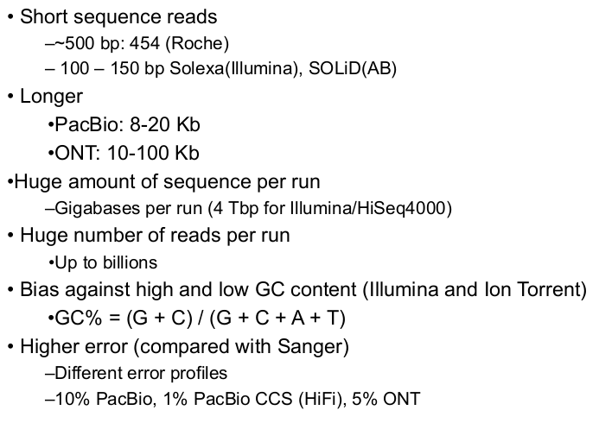
Capillary(Sanger) Sequencing
Sanger (1977) and Gilbert (1977) methods.
Sequencing by Hybridization (SBH): 1988 first occurrence, 1991 Light directed polymer synthesis by Steve Fodor, 1994 first 64-kb DNA microarray by Affymetrix.
- Attach all possible DNA probes of length l to a flat surface, each probe at a distinct and known location. This is the DNA array.
- Apply a solution containing fluorescently labeled DNA fragment to the array.
- The DNA fragment hybridizes with those probes that are complementary to substrings of length l of the fragment.
Using a spectroscopic detector, determine which probes hybridize to the DNA fragment to obtain the l–mer composition.
l–mer composition: Spectrum(s,l) is an unorder multiset of (n-l+1) l-mers of string s of length n. Set, so order doesn't matter. Do a Hamiltonian path (each vertex visited once) to construct predecessor relationships. Or do Eulerian path (each edge visited once) based on 1 shift & 1 insert (De Bruijn) difference.
- Fidelity of Hybridization: difficult to detect small errors
- Array Size: Fidelity can be addressed with longer l-mers, but array size increases exponentially in l, which is limited by technology.
- Not practical, but spearheaded further techniques.
Gel electrophoresis: Start at primer (restriction Site), Grow DNA chain, Include dideoxynucleotide (modified a, c, g, t), Stops reaction at all possible points, separate products with length using gel electrophoresis, challenging to read due to signal errors.
PHRED & PHRAP (by Phil Green): Do signal operations to filter the output, apply DP for PHRED; use genome assembler in addition for PHRAP.
Capillary sequencing can do ~1000 letters at a time
- Double-barrelled sequencing: Circular shape that reads both ends separated by a known separator sequence, outputs error probabilities as ASCII char values as -10log_10 (probability of error).
- About > 7*fold overlap redundancy, 10 is enough to reduce error to 1 in every 1,000,000-base
Sanger sequencing analysis: long reads(1000 base-pairs), low error(<0.1%), cloning libraries applicable, BUT expensive & cloning is hard and time consuming.
High-Throughput Sequencing (HTS)
Random cuts with various sizes, paired-end sequencing and read-mapping to find appropriate place for the piecec based on reference genome (HGP)
- Pyrosequencing (by 454 Life Sciences): The first, acquired by Roche
- Illumina (Solexa): Sequencing by synthesis. GAIIx, HiSeq2000-2500-3000-4000, X Ten, NextSeq, MiSeq, NovaSeq, NovaSeq2
- SOLiD (color-space reads) and Ion Torrent (by Applied Biosystems)
- PacBio (by Pacific Biosciences)
- ONT (by Oxford Nanopore)
Application Areas: Genome re-sequencing: somatic mutation detection, organismal SNP discovery, mutational proﬁling, structural variation discovery, de novo assembly (constructing genomes from DNA fragments, with no a prior knowledge of sequence or order of the fragments), DNA-protein interaction analysis (ChiP-Seq), novel transcript discovery, quantiﬁcation of gene expression, epigenetic analysis (methylation proﬁling)
Fundamental challanges: Interpreting machine readouts - base calling, base error estimation; data visualization, storage and data management for large genomes; SNP, indel, and structural variation discovery; de novo assembly
Illumina (Solexa): Current market leader, Based on sequencing by synthesis, Current read 100-150bp up to 300 with errors, paired end reading, ~0.1% error from mismatches, 6 Tera base-pair reads in a single 2-day run, cheapest so far
Ion Torrent: Sequencing on a microprocessor that measuring pH level w.r.t. bases, indel & homopolymers dominated ~1% error, matepair sequencing possible but difficult
PacBio: 'Third generation' single molecule real time sequencing (SMRT), no replication with PCR, labeled phosphates watching artificial slow DNA polymerase, long reads ~ 10-80 Kbase, indel-dominated ~10% error
Any enzyme reads 70 Kbase median sequence, CLR: single read,CCS: circular reads of 5-6 times renamed HiFi based on MSA for error correction, 10 Kbase median with ~1% error
Nanopore Sequencing: 2 Mega base-pair reads, ~5% indel dominated error, recurrent net to guess the bases, works in real-time, 100 Kbase with ~20% error reduced to 5% nowadays (MinION, SmidgION, PromethION)
HTS Challenges
- Data is large, compression.
- Read mapping – finding segment location
- Variations discovery
- De novo assembly, especially if high error
Compression
Reference based: Embedding rather than compression, high compression rate, fast to encode slow to decode, needs reference genome which can be infeasible & needs mapping, lossy. CRAMtools, SlimGene, etc.
Reference-free: Less compression, no reference, slow to compress but faster to decompress, lossy or lossless. gzip, bzip2, 7zip etc. Specialized FASTQ compressors like CALCE, ReCoil, G-SQZ, etc. Algorithm is concat the text & run Lempel-Ziv algorithm. Locality needed!
Lempel-Ziv algorithm: Iteratively build a lookup of previously observed keywords & iteratively encode afterwards. High locality ensures lookup fills slowly & improves performance.

Slide 5
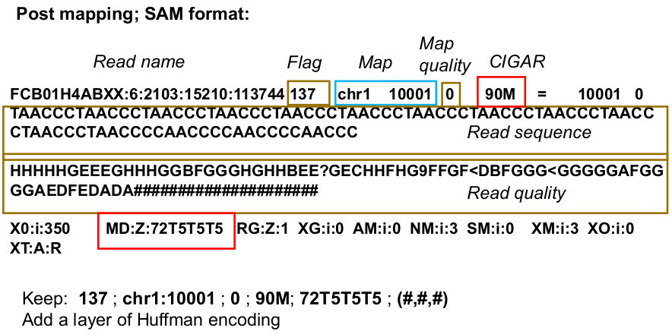
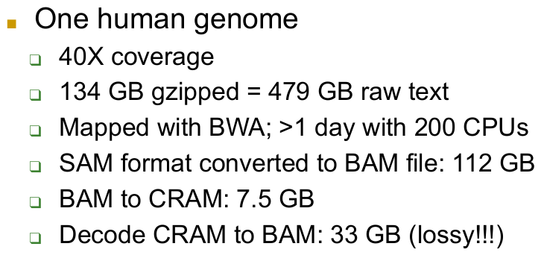
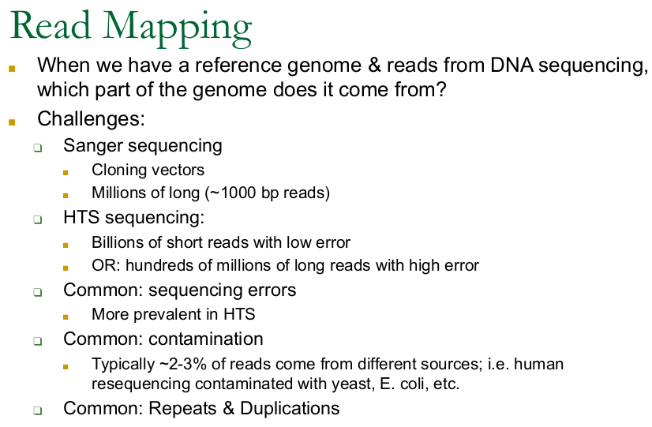
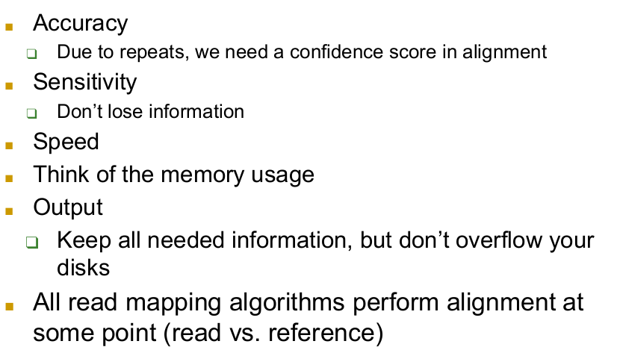
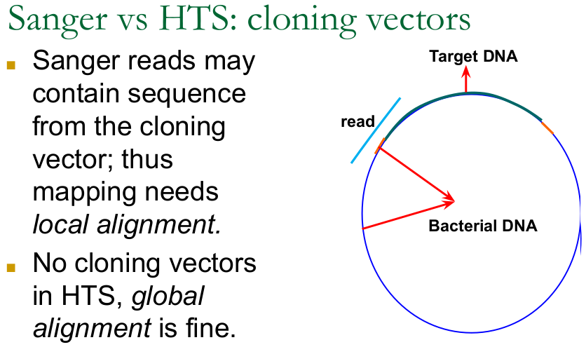
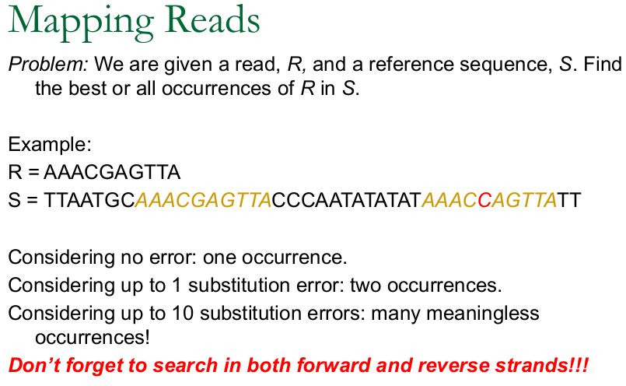
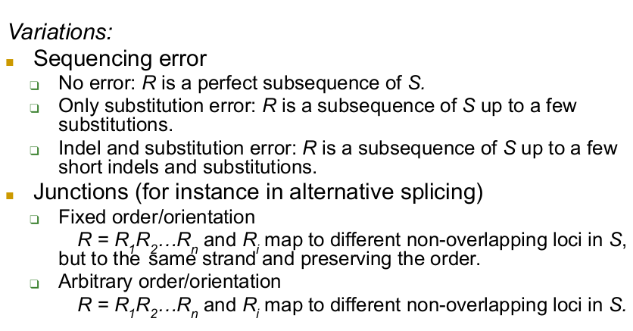
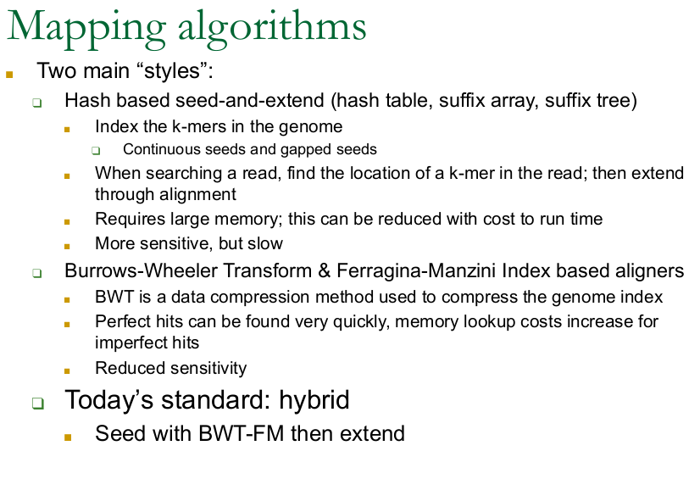
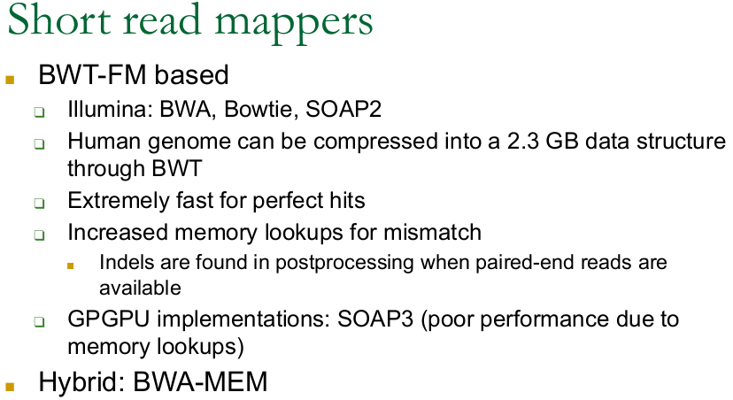
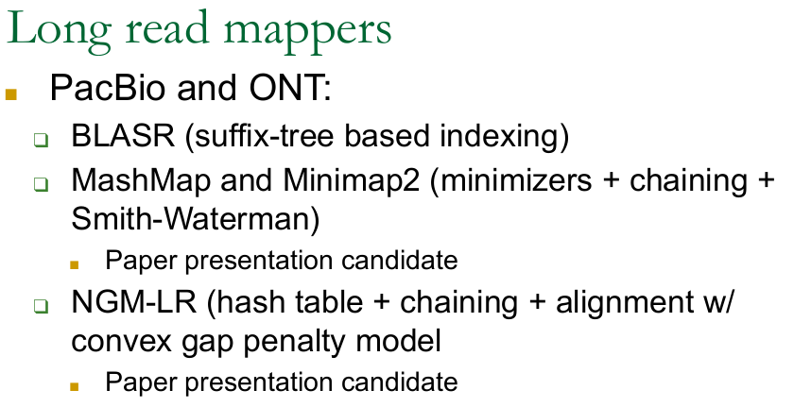

Slide 6
